Slide 1
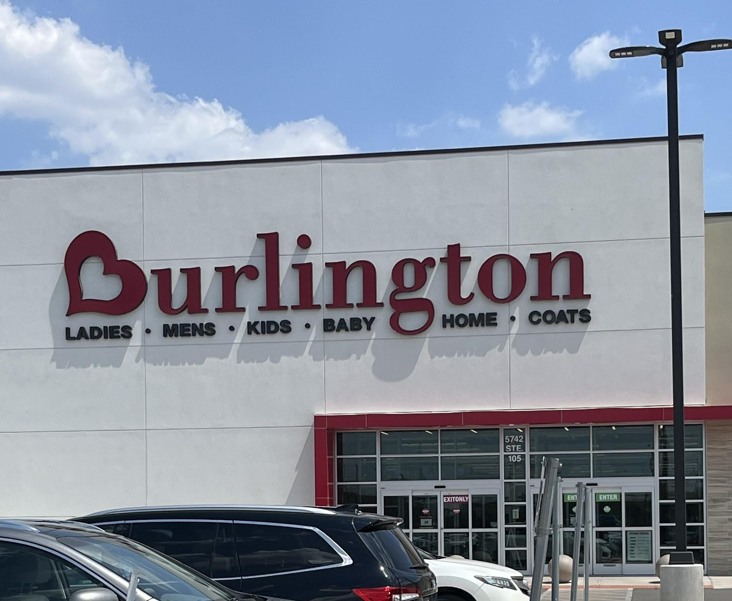
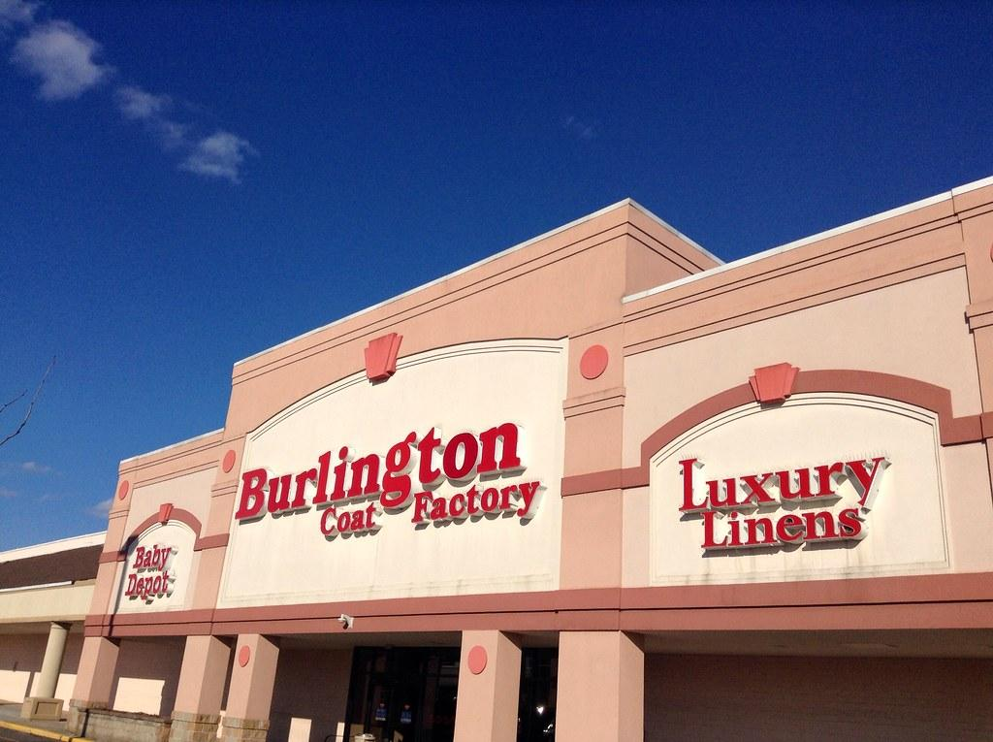
GROUP 5
Burlington Corporation
Garfield, NJ
Contributors
Carley Thompson, Lara Ergen, Alex Sendecki, Tyce Cannon, Mayuri Acharya

Slide 2

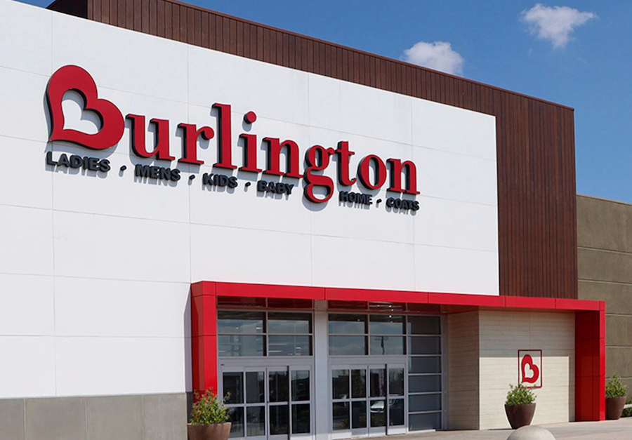
Company Access
Group 5
Group 5
Burlington is a national off-price retail store specializing in popular brands at discounted costs.
“The premier off price retailer” (Our History | Burlington Stores, Inc.)
Founded in 1972 in Burlington, NJ
By Monroe and Henrietta Milstein
Garfield location (opened in 2016): 174 Passaic Street, Suite 252, Garfield NJ 07026
Nationally 1,212 stores
Main Contact: Arzu Ergen
Store Manager
arzuergen@hotmail.com
Burlington
Burlington
Burlington

Slide 3
Background Information and Secondary Data
Company Overview
Group 5
Off-Price Retail Industry + Burlington Workforce Trends
Industry + Competition
Workforce Trends
Burlington competes in the off-price retail market with TJ Maxx, Marshalls, HomeGoods, Ross, and JCPenney
The Garfield location is near other discount retailers, including Walmart and Marshalls, making the area highly competitive
Secondary research helped connect our project to larger issues in retail: staffing, motivation, compensation, and retention
Burlington has about 77,000 employees nationally, with an average of about 60 employees per store
Common store roles include Store Manager, Assistant Store Manager, Supervisor, Customer Service Lead, Sales Associate, and Cashier
Employee turnover is a major concern, with about 70% of employees staying less than 2 years
Company Name
Burlington
Sources: Burlington Stores, inc, Business Research Insights, Garje, Yahoo Finance
Burlington
Notes:
Burlington competes in the off-price retail market with TJ Maxx, Marshalls, HomeGoods, Ross, and JCPenney.
The Garfield location is near other discount retailers, including Walmart and Marshalls, making the area highly competitive.
Burlington has about 77,000 employees nationally, with an average of about 60 employees per store.
Common store roles include Store Manager, Assistant Store Manager, Supervisor, Customer Service Lead, Sales Associate, and Cashier.
Employee turnover is a major concern, with about 70% of employees staying less than 2 years.
Secondary research helped connect our project to larger issues in retail: staffing, motivation, compensation, and retention.

Slide 4

Data Collection and Timeline
Group 5
Finding a Solution
Finding a Solution
Data Collection Methods : Interviews, Surveys, and Secondary Research
1
2
3
4
5
6
Initial Meeting
Feb. 12
Follow- Up Meeting
March. 13
Manager Interview
Mar. 17
Employee Interview
Mar. 19
Employee Interview
Apr. 1
Survey + Research
Final Step
50
Discussed and narrowed the issue to payroll constraints, employee hours, turnover, and motivation
Interviewed Nesrin Selman to get a second management perspective
Interviewed Maria Tapale about compensation, morale, recognition, and motivation
Interviewed Natasha Talevska about scheduling, fairness, limited hours, and recognition
Used employee survey responses and secondary research to support our project
Met with Arzu Ergen to learn more about Burlington's background and early concerns
40
Users (in millions)
30
20
10
YEAR 3
YEAR 1
YEAR 2
YEAR 4
YEAR 5
Years
Company Name
Company Name
Burlington

Slide 5
Management Issue/Output Problem
Finding a Solution
Finding a Solution
Group 5
Output problem: high employee turnover combined with low employee motivation, driven by payroll constraints, limited work hours, dissatisfaction with compensation, inconsistent recognition, and concerns about fairness regarding scheduling and treating employees
High turnover leads to less staffing stability and weaker long-term commitment to the store
Low morale affects operational performance, including stocking, teamwork, efficiency, and customer service
Poor communication with little to no recognition can create shifts between managers and employees, making it harder to build a motivated team
  Managers focused more on payroll limits, scheduling difficulties, and retention, while employees feel more underpaid, underappreciated, and less motivated to stay for a long time
Bottom line: Burlington's challenge at the Garfield location is not solely a staffing issue, but also a human-centered management issue involving motivation, appreciation, communications, and retention
Company Name
Company Name
Burlington

Slide 6
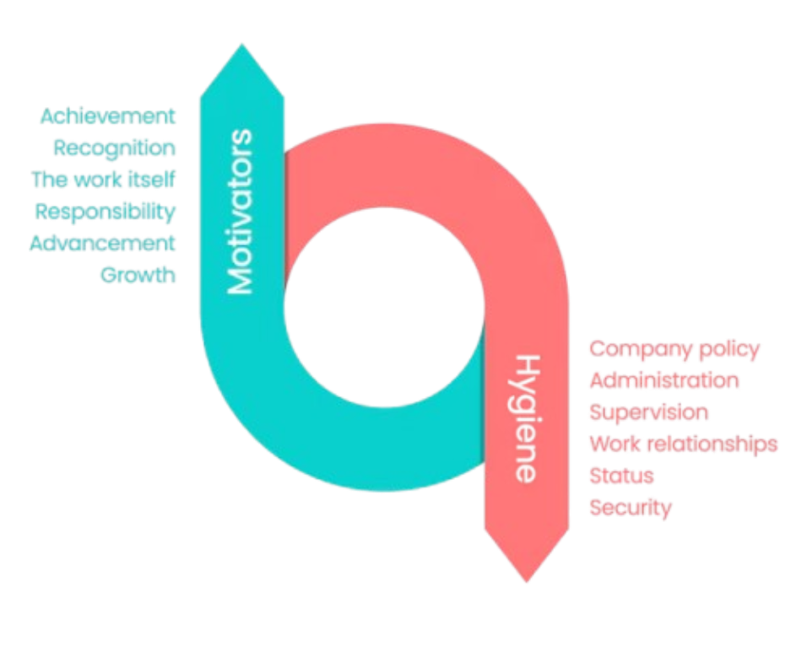
Herzberg’s Motivation-Hygiene Theory
Group 5
Group 5
Motivators: job related factors related to satisfaction
Hygiene factors: working environment factors that lead to job dissatisfaction
There are separate and distinct clusters of factors related to job satisfaction
Satisfaction does not equal dissatisfaction
They are independent of each other
Eliminate dissatisfaction then foster motivation
Burlington
Burlington
Burlington

Slide 7
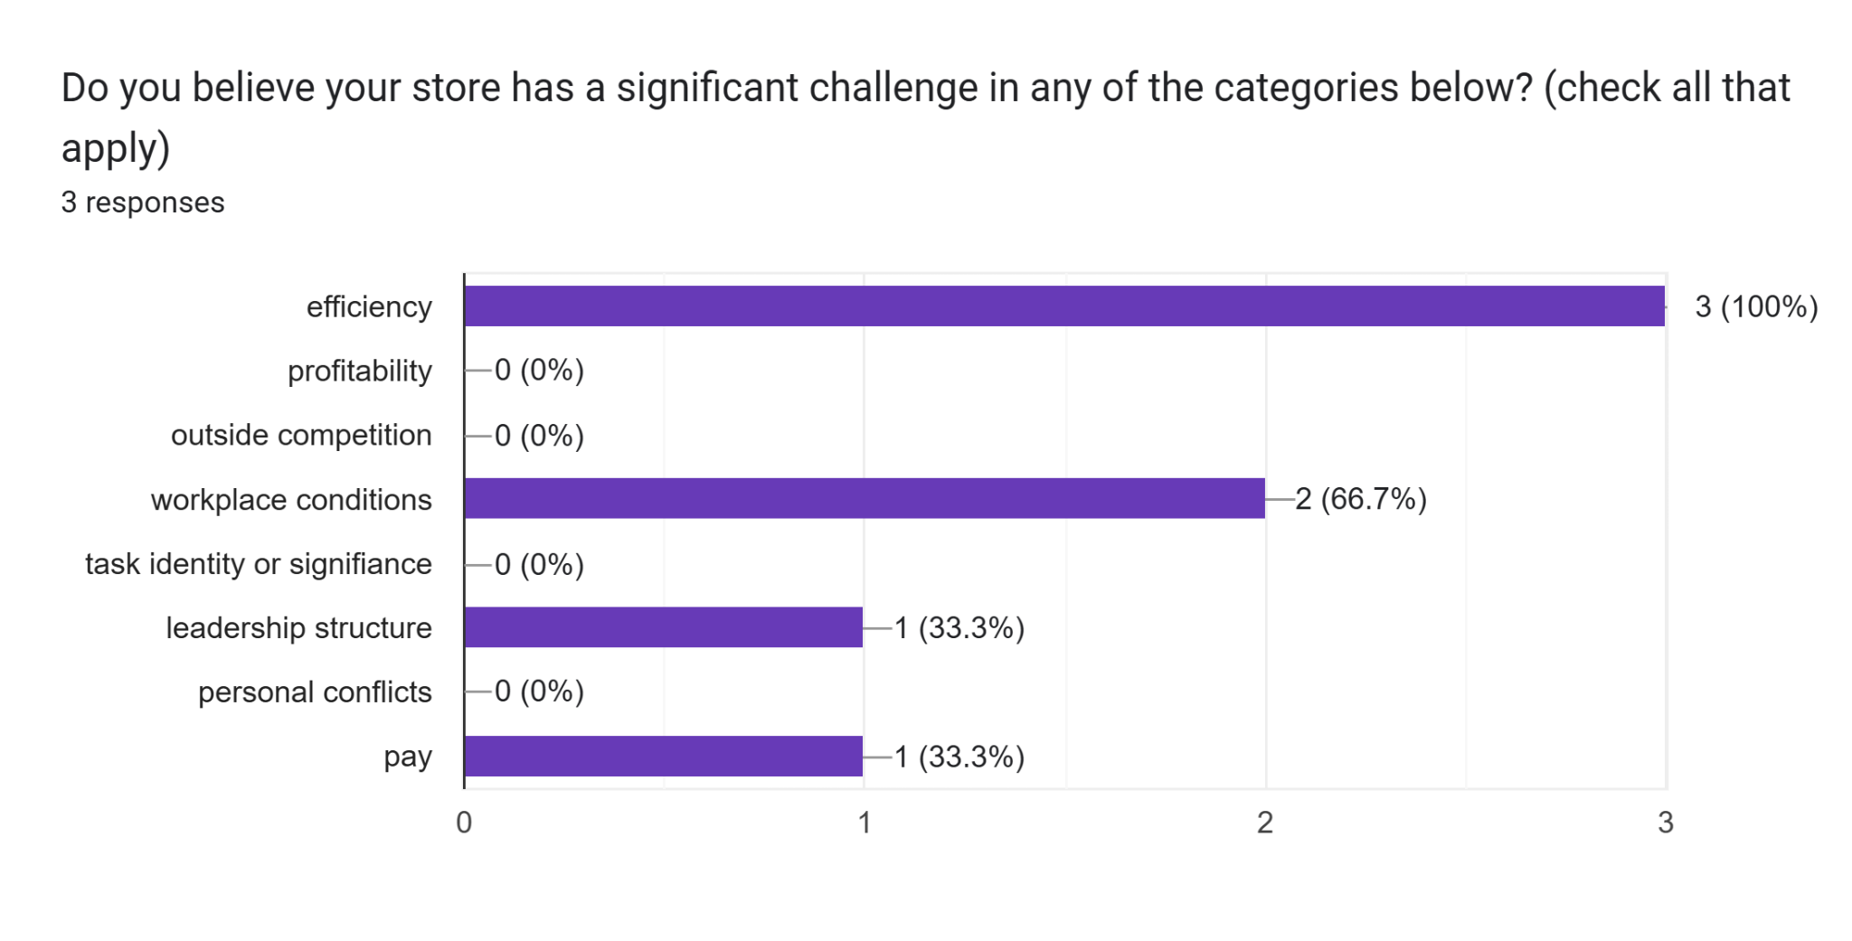
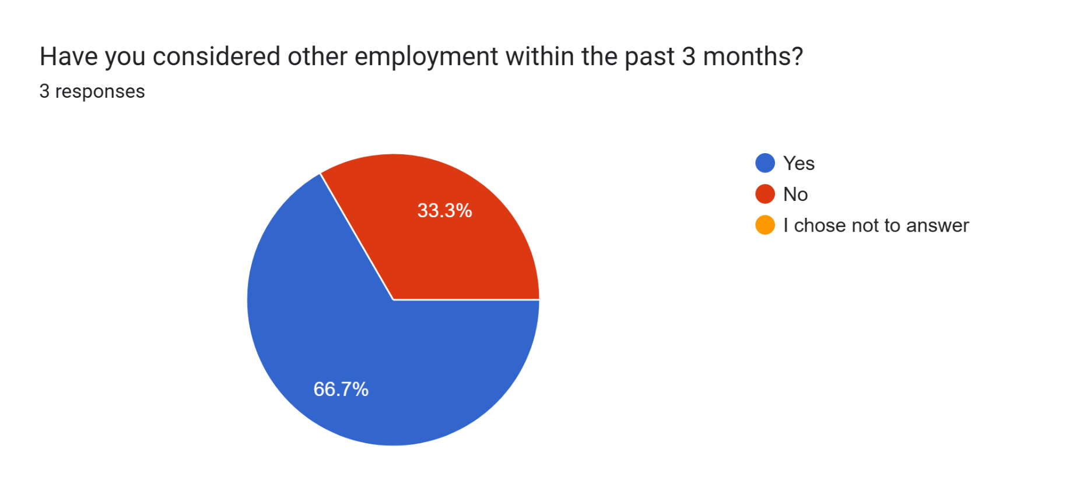
Hygiene Motivation Theory at Burlington
Group 5
Group 5
Believing compensation and incentives are not equal to their work
Employees feel “undervalued” and “recognition and feedback was inconsistent” (Natasha Talevska)
Survey complaints of pay (hygiene factor)
Low company morale and high employee turnover due to a lack of motivation
Creates job dissatisfaction and low satisfaction levels
Burlington
Burlington
Burlington

Slide 8
Continued
Group 5
Group 5
Burlington’s motivation factors: low achievement, recognition, and advancement
Hygiene Factors: unhappiness with salary, rewards, and satisfactory conditions
High Dissatisfaction leads to short employee tenure, and additionally stresses inconsistent scheduling and reliability
Financial and economic instability pushes employees to prioritize their compensation when choosing a workplace
None of survey respondents ranked wages as a benefit of Burlington
Employee satisfaction is crucial to maintain to keep staff motivated, successful, and productive
Desire goal: improve satisfaction (motivators) and lower dissatisfaction (hygiene factors)
Burlington
Burlington
Burlington

Slide 9
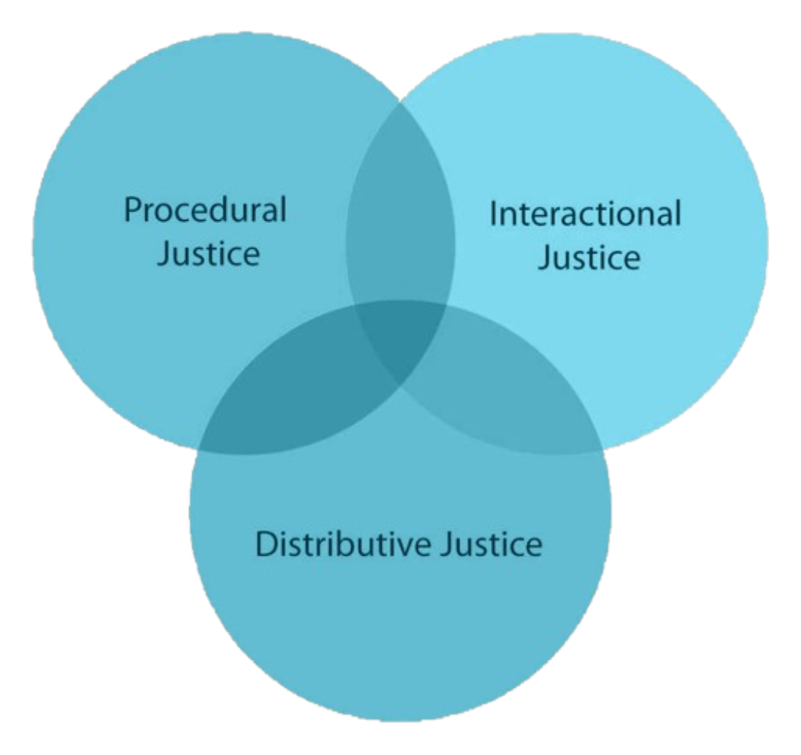
Distributive/Procedural Justice
Group 5
Distributive Justice: employee judgements about the appropriateness of resource allocation
Did you get your fair share?
Based on equality, equity, and need
Procedural Justice: employee judgments about the fairness of how decisions are made or implemented
Were the procedures used to determine the outcome fair?
Based on consistency, bias-free, neutrality, and ethics
Managers = distributive
Employees = procedural
Burlington

Slide 10
Evidence and Integration: Distributive Justice
Group 5
Poor employee perceptions of fairness with scheduling and compensation
Interview theme → payroll constraints affected hours available to employees
  Employees perceive these limitations as unfair, even though managers are aware of budget constraints higher management has for payroll
Managerial level: Arzu Ergen → previous managers had left after their compensation did not match their desired value
Key finding: resource distribution viewed as unequal among employees, even though structurally, the store bases hours on what they believe is required for daily operations within payroll constraints
Burlington
Burlington

Slide 11
Evidence and Integration: Procedural Justice
Company Overview
Group 5
Poor employee evaluations of fair communication and decision-making
Employee level: Natasha Talevska → unsure of how scheduling decisions were exactly made across the management team
  Communication between employees and managers (recognition and feedback) was inconsistent
Managerial level: Arzu Ergen → “people work for people”
  Importance of building relationships with employees and providing individualized feedback
    Problem: managers may not be able to consistently explain scheduling decisions and deliver the same level of feedback to ALL employees
Key finding: disconnect between what managers intend to provide their employees and how employees perceive these actions as unfair
Company Name
Burlington
Burlington

Slide 12
Recommendation 1
Implement a consistent recognition system for the next three months in its daily operations to ensure feedback needs are met across employees
Short weekly team meetings before shifts → managers can recognize specific employee contributions to helping operational goals in customer service or efficiency
  All employees should be encouraged to recognize each other during meetings to increase peer-to-peer motivation
One-on-one meetings between managers and employees for specific performance feedback
Recognition is consistent rather than occasional, and still builds upon current initiatives like the WOW board
Gallup → “teams that report they receive adequate recognition have 19% less turnover than teams that say they don't receive enough recognition” (Robison)
  Motivation is key to turnover, not just wages
Group 5
Burlington

Slide 13
Best Practices
Potential Downsides
Group 5
Google → Project Oxygen
  Implementing consistent, clear feedback = one of the ways managers could become more effective
  Communicating expectations directly to employees meant managers could improve performance and engagement across the team (Garvin)
    Supports the recommendation for Burlington’s weekly feedback meetings
Adobe → digital check-in system
  Employees and managers encouraged to have continuous year-round feedback sessions, coaching, and recognition (Adobe)
  Instead of annual performance reviews, consistent feedback = increased engagement along with reduced turnover across the organization
Managers may make feedback feel forced → only doing what higher management is telling them to do
  Feedback sessions feel like a routine (“robotic”) to complete vs. time to authentically provide feedback
    Interview theme → payroll constraints for managers = less effort into engagement initiatives
Cost factor → time used for operational activities
  Hours taken away to conduct meetings with the team/one-on-one
  Time needed to train managers on how to effectively deliver feedback and conduct employee meetings
Backfire → increased recognition efforts end up becoming biased
  If some employees receive more feedback than others, (unintentional or intentional) this could represent unequal appreciation vs. equal value
  Distributive justice → employee perceptions of fairness become more sensitive if the system is implemented poorly or if feedback is not provided across the team equally
Burlington

Slide 14
Recommendation 2
Finding a Solution
Group 5
Focusing on both distributive and procedural justice at Burlington could create a system where rewards and decisions follow clear and fair rules
For the next three months, managers will follow explicit criteria for scheduling decisions, including performance evaluations, availability of employees, and operational demand
The managers will explain how decisions happen and gather employee input through bi-weekly schedule explanations, where managers could discuss how decisions were made
Employees will be able to ask about raises, promotions, and what other actions they can take to increase their hours and opportunities during one-on-one check-ins
Company Name
Burlington

Slide 15
Best Practices
Finding a Solution
Group 5
Potential Downsides
Costco: Fair pay, strong benefits, and clear advancement opportunities for all employees
Costco, pays above retail averages and provide health coverage, retirement plans, and stable hours which incentives a lower turnover rate which Burlington struggles with
Of the employees surveyed, none quoted pay and incentives as a successful quality of Burlington
Whole Foods: Open communication during meetings in order to discuss performance as a whole across the team
It ensures clarity about the level of fairness across the store as a whole
This helps potentially negate any limitations the store may have in terms of wages and payroll
At the corporate level, higher management may limit the flexibility of transparent information on decision-making and scheduling
Employees might still feel that decisions are not fair, since the rules are made without explanation by higher management
To meet the expectations of managers for longer hours, employees may take shortcuts
Employees are now able to highlight inequalities even further, thus increasing dissatisfaction across the store
When employees become more cognizant of the issues around them and the perceptions other coworkers have about fairness, these employees may also change their personal beliefs to match them
Company Name
Burlington

Slide 16
Communication Strategies and Influencing Tactics
Group 5
Social proof can combat issues of implementation
Burlington can highlight other organizations’ successes in order to emphasize to employees why it is important for the company itself to also implement their own systems
By seeing how large companies such as Costco and Adobe have managed to improve their recognition efforts and fairness perceptions, employees will feel motivated to replicate that success for Burlington
Authority at Burlington can help with credibility of these new initiatives
Showing results and data on fairness and motivation from Gallup, Harvard Business Review, and other reputable sources could help strengthen the credibility of these initiatives and gather more employees and managers on board with the changes
Using statistics and data as indicators of success, Burlington’s output problem can be compared to similar problems other companies have
This can help with influencing implementation of these initiatives
Market Analysis
Burlington
Company Name

